Slide 1


Slide 2

Database Connectivity
Week 07 - Day 04
Atta Muhammad
attapanhyar@quest.edu.pk
+923331971110
Quaid-e-Awam University of Engineering, Science and Technology

Slide 3
Objectives
Understand data visualization basics.
Explore Python libraries for visualization.
Practice with Matplotlib and Seaborn.

Slide 4
Introduction to Data Visualization
Definition and importance of data visualization in Python.
Key libraries: Matplotlib, Seaborn, and Plotly

Slide 5
Installing Required Libraries
Code: pip install matplotlib seaborn plotly
Explanation of each library’s primary use.

Slide 6
Getting Started with Matplotlib
Overview of Matplotlib’s capabilities.
Code: Basic import
import matplotlib.pyplot as plt

Slide 7
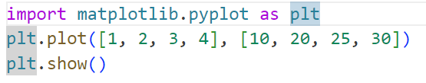
Basic Plotting with Matplotlib
Code example for a line plot:

Slide 8
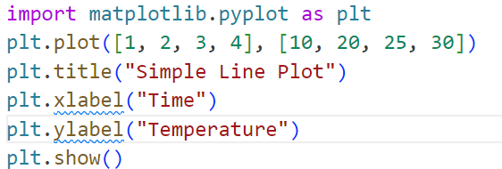
Customizing Plots - Titles and Labels

Slide 9
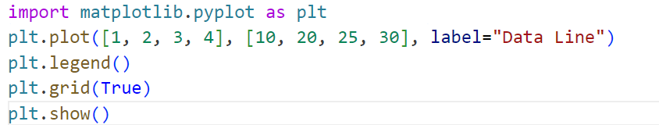
Adding Legends and Grid

Slide 10
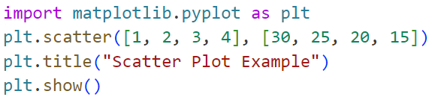
Plot Types - Scatter Plot

Slide 11
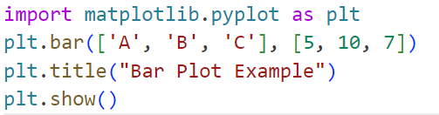
Plot Types - Bar Plot

Slide 12
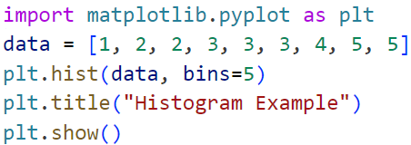
Working with Histograms

Slide 13
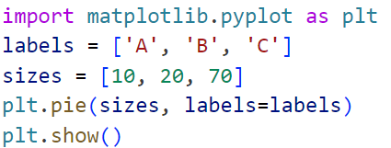
Pie Charts for Categorical Data

Slide 14
Introduction to Seaborn
Overview of Seaborn and its connection to Matplotlib.
Benefits for statistical data visualization

Slide 15
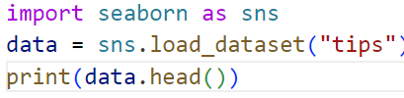
Seaborn - Loading Sample Data

Slide 16
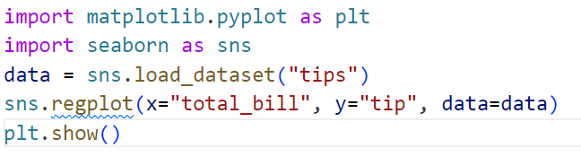
Seaborn - Scatter Plots with Regression Line

Slide 17
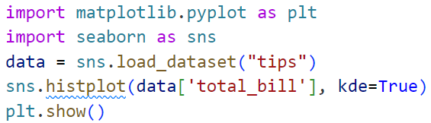
Seaborn - Histogram and KDE

Slide 18
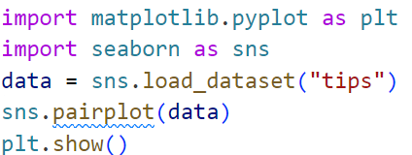
Seaborn - Pair Plot

Slide 19
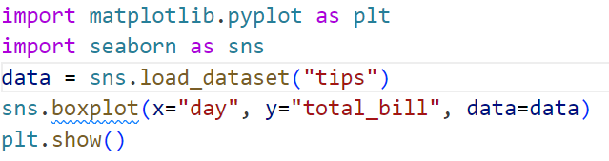
Seaborn - Box Plot

Slide 20
Introduction to Plotly
Overview and benefits of interactive visualizations in Plotly.

Slide 21
Plotly - Simple Line Plot

Slide 22
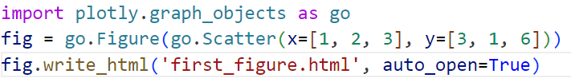
Plotly - Interactive Bar Chart

Slide 23
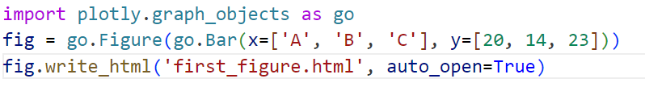
Plotly - Interactive Bar Chart

Slide 24
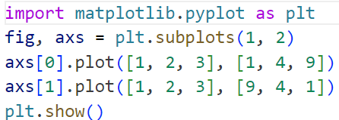
Creating Subplots in Matplotlib

Slide 25
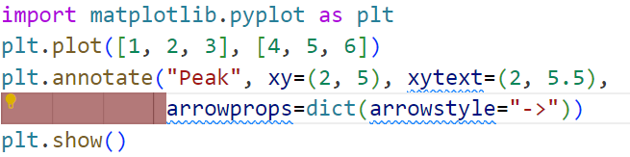
Annotations in Matplotlib

Slide 26
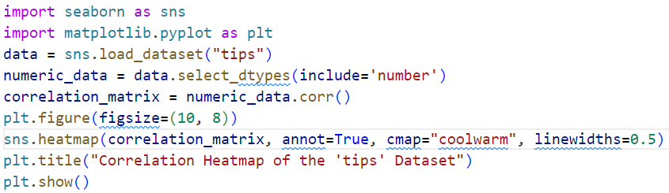
Advanced Plotting in Seaborn - Heatmap

Slide 27


